Slide 1

INFO 6150: Web DesiGN Skill spark

Slide 2
GROUP NUMBER : 14
MEMBERS :
Navin Sharma – 002737702
Atharva Danke – 002762773
Meenal Sarwaiya – 002737278
Ruchi Kapadiwala – 002772936
Charmi Parmar – 002766700

Slide 3
objectives
To provide a platform that connects users with a variety of in-person classes in their area, catering to a wide range of interests and activities.
To partner with local instructors and studios to offer a diverse range of classes and experiences to users.
To make it easy for users to search for and book classes online based on their interests, location, and availability.
To offer resources for users to discover new activities and connect with a community of learners and instructors.
To provide a platform for users to rate and review their classes, share their experiences with others, and create their own groups and events for others to join.

Slide 4





TECHNOLOGIES USED :
Frontend: HTML, CSS, Bootstrap
Frontend Framework: React
Backend: Express JS
Database Connectivity: MongoDB

Slide 5
Libraries used :
React Bootstrap
Node Mailer
Bycrypt
Mangoose
http proxy middleware

Slide 6
Pages in our Project
Home
About
Why choose Skill Spark
Classes
Gallery
Contact Us
Salsa Classes
Hip hop Classes
Ballet Classes
Baking Classes
Healthy Cooking Classes
Kids Cooking Classes
Zumba Classes
Aerobics Classes
Pilates Classes
Hiking Classes
Rock Climbing Classes
Horse Riding Classes
Cricket Classes
Football Classes
Soccer Classes
Painting Classes
Knitting Classes
Pottery Classes
User Registration
User Login
User Dashboard
Update Personal Details
Classes Registration
Classes Login
Classes Dashboard
Update Classes
Admin Login
Admin CRUD – Users
Admin CRUD – Classes

Slide 7
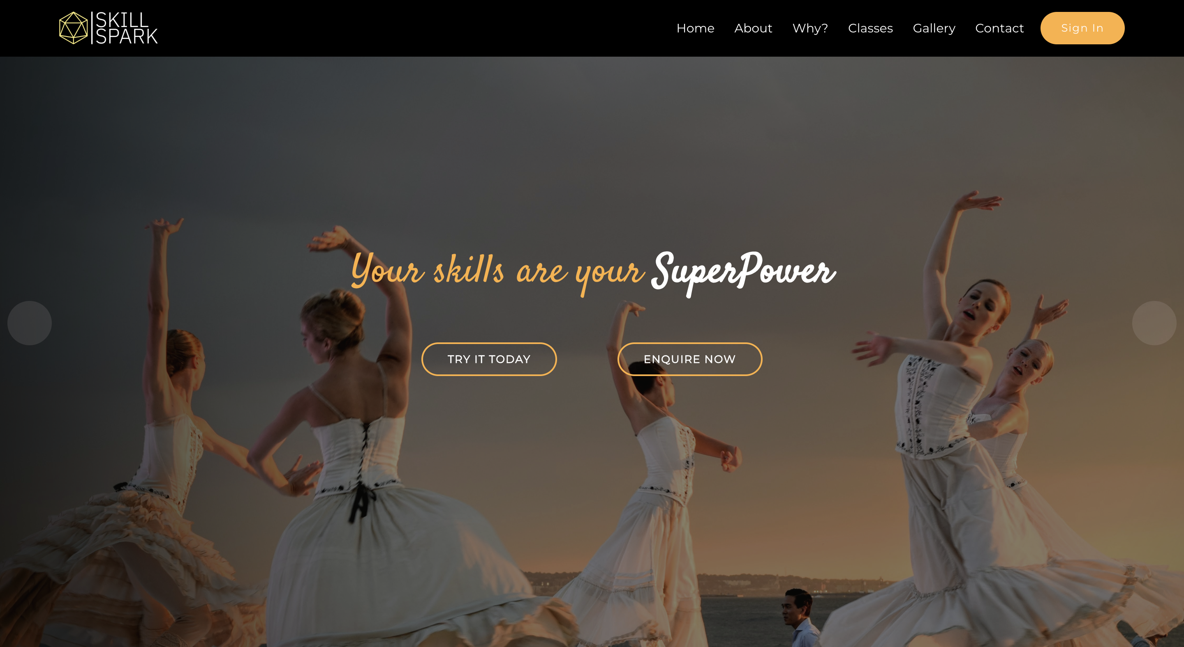
HOME PAGE

Slide 8

USER FUNCTIONALITIES
SignUp as a new user
Login
View Dashboard
Rate and View Classes

Slide 9
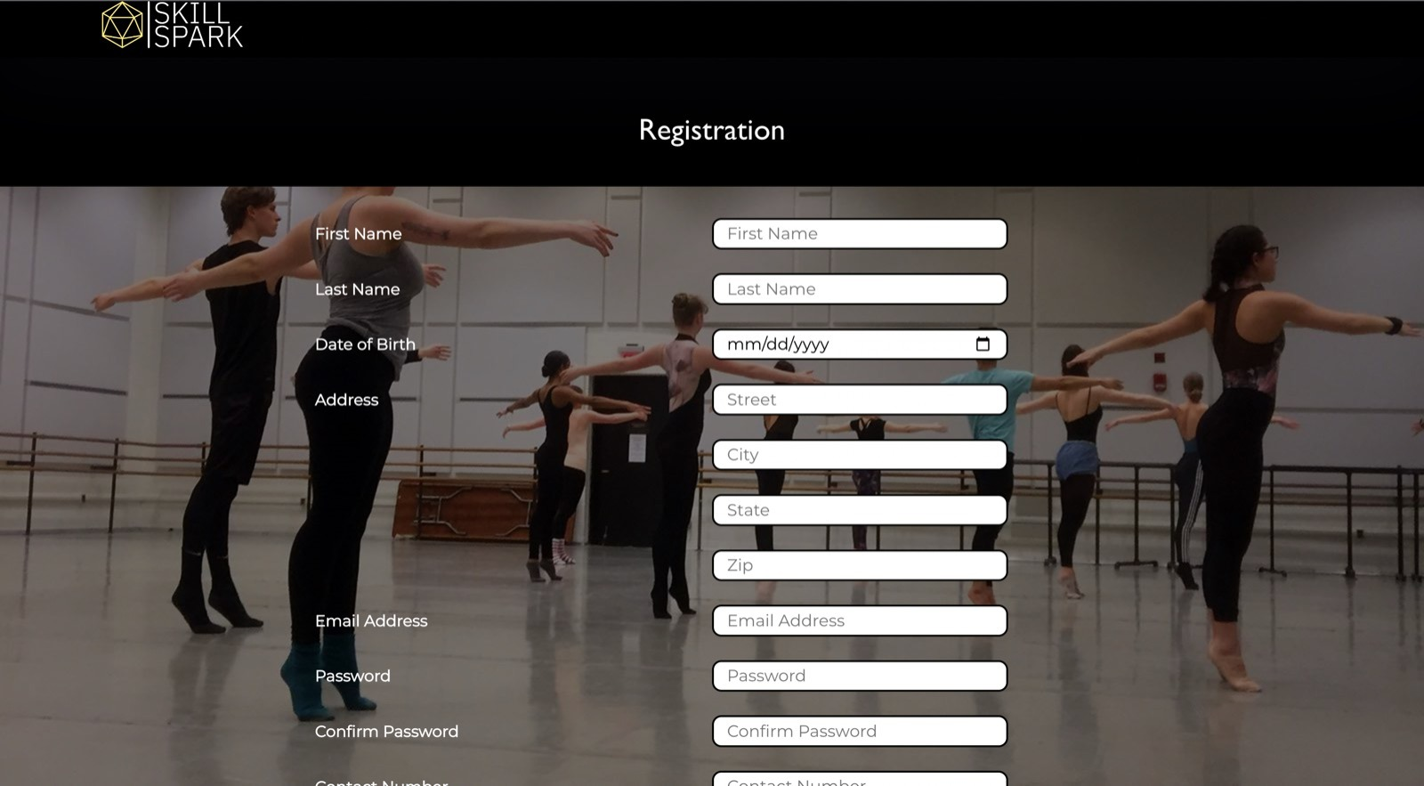
User Registration Page

Slide 10
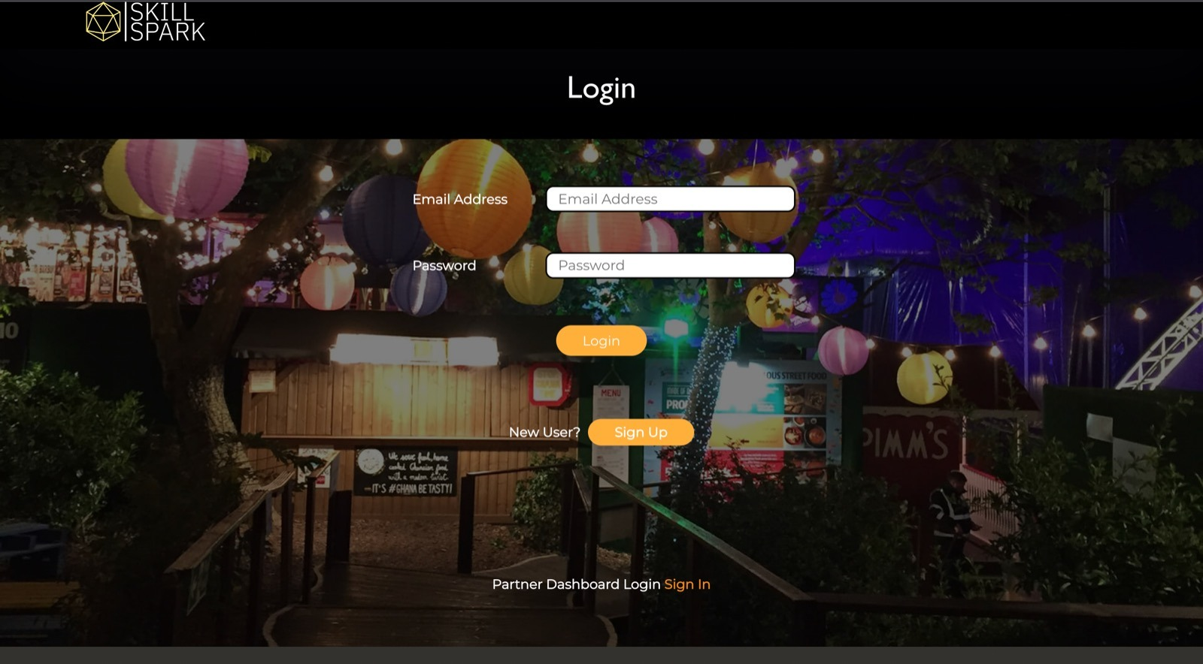
User Login Page

Slide 11
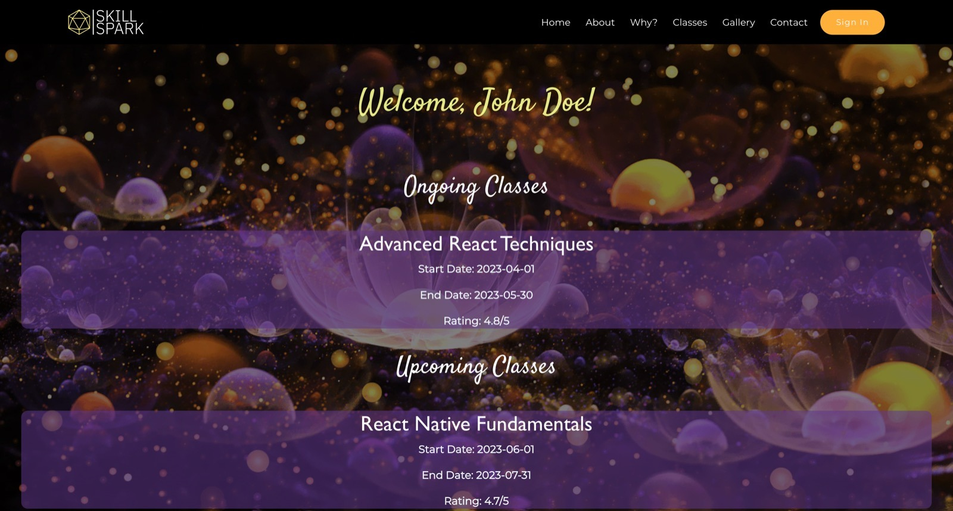
User Dashboard

Slide 12
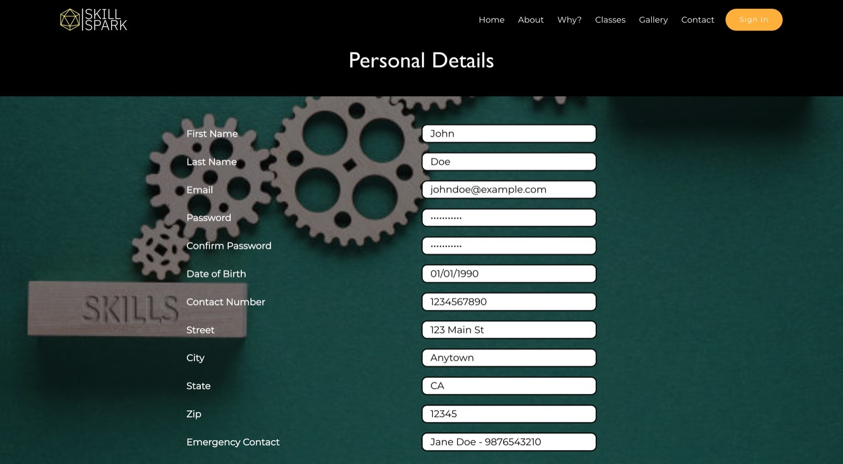
Update User Personal Details

Slide 13

CLASSES FUNCTIONALITIES
SignUp as a new user
Login
View Dashboard
Rate and View Classes

Slide 14
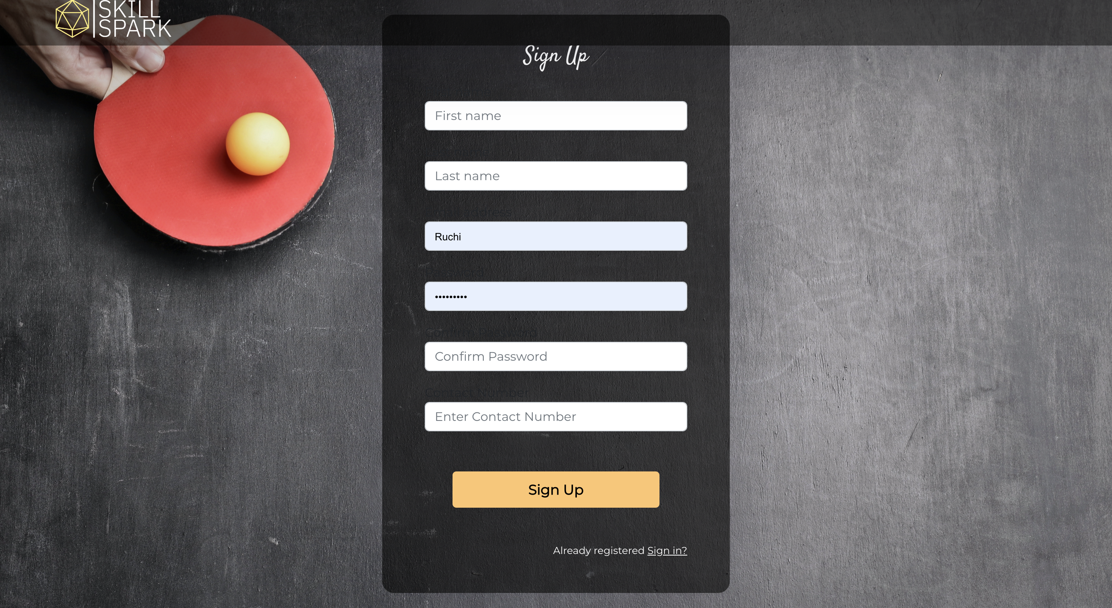
Classes Registration Page

Slide 15
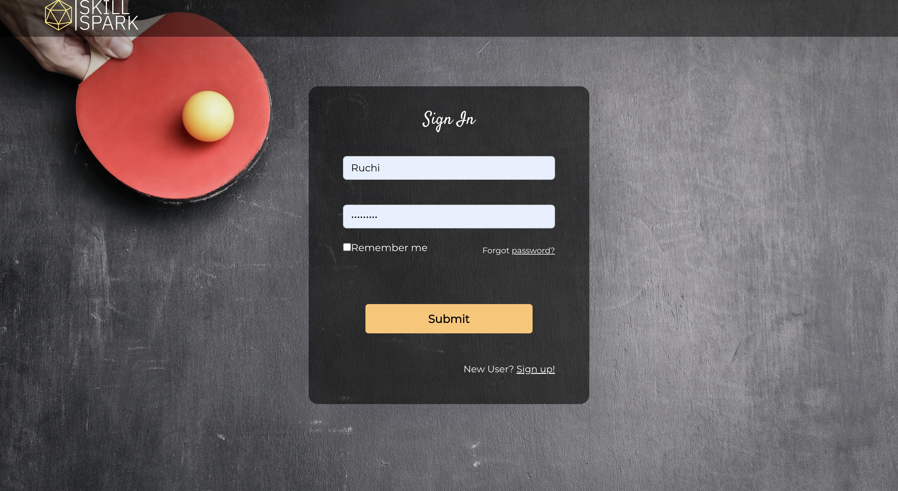
Classes Login Page

Slide 16
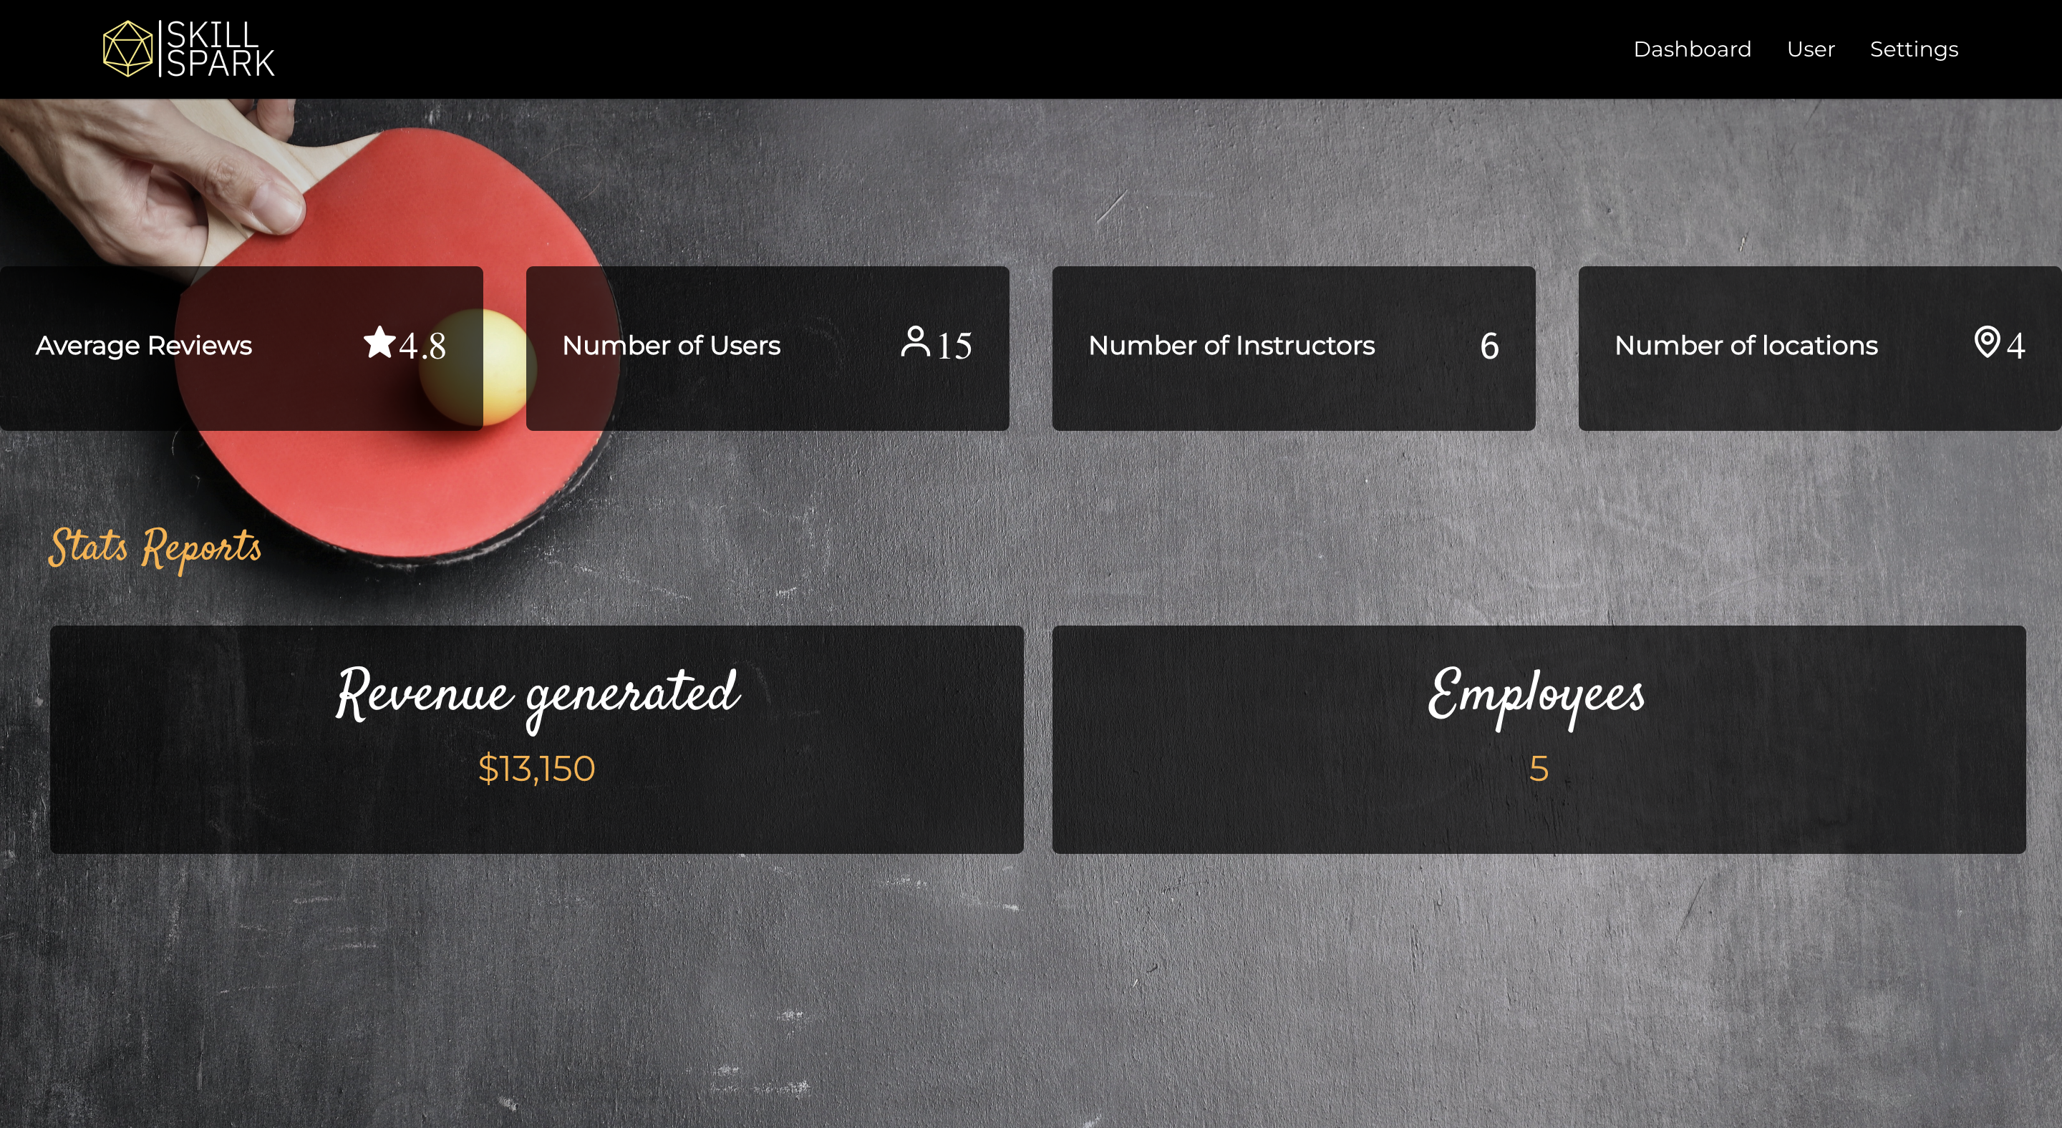
Classes Dashboard

Slide 17

ADMIN FUNCTIONALITIES
Manage Users
Manage Classes
CRUD on all
View Dashboard
Rate and View Users’ Reviews
Rate and View Classes’ Reviews

Slide 18
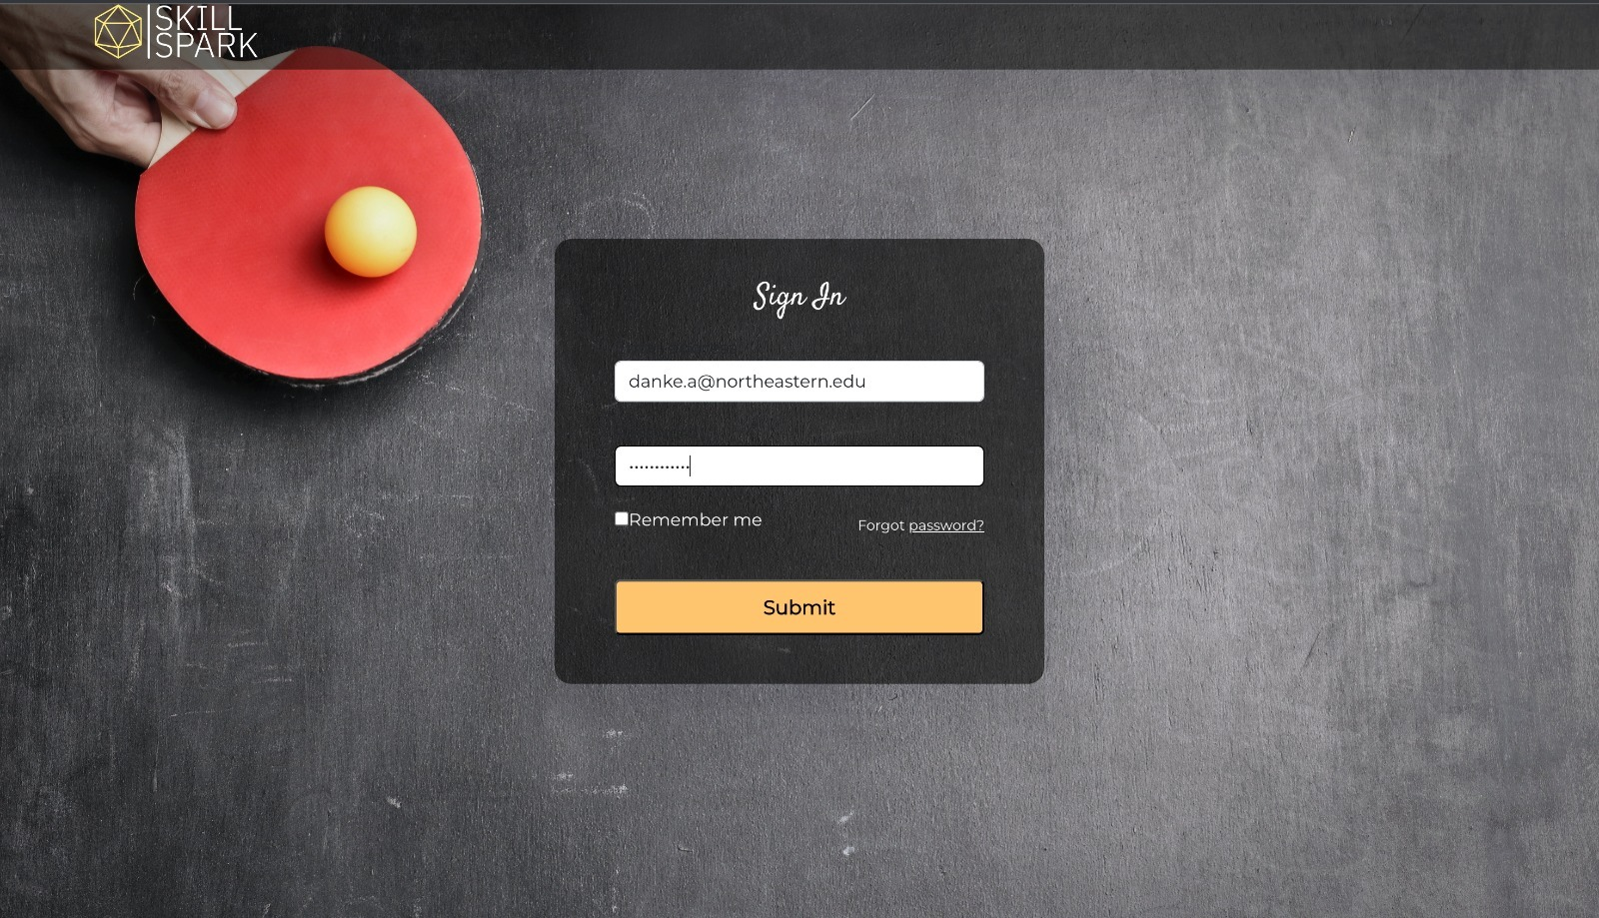
Admin User
Admin Sign In

Slide 19
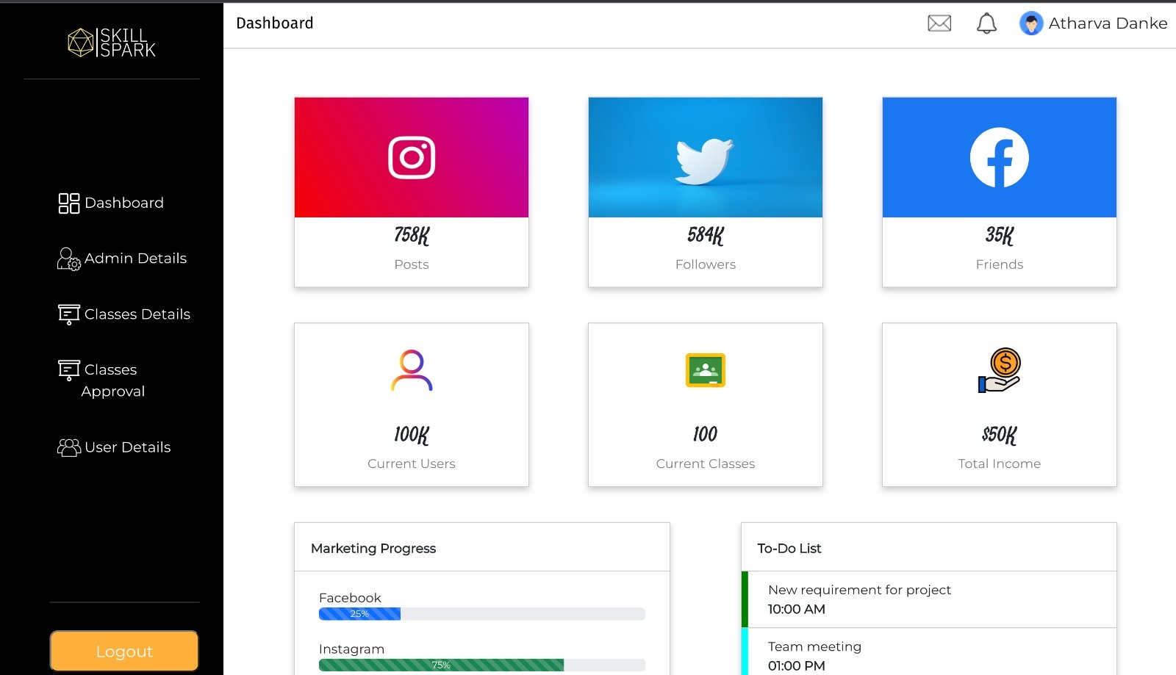
Admin User
Dashboard

Slide 20
-THANK YOU-

